Slide 1
Spark Structured Query Language
and
Spark DataFrames

Slide 2
Table of contents
Spark SQL - Introduction
History of Spark APIs.
Overview of the DataFrames API / Library.
Creating a DataFrame.
Overview of the Datasets API.
Pandas vs. PySpark DataFrame.
Overview of SparkSession.
SparkSession Commonly Used Methods.
Spark SQL Built-in Standard Functions.
How to Create a DataFrames
Creating DataFrames - spark.read().
Creating DataFrames from new RDD /Existing RDD.
Creating DataFrames from Data sources.
Overview to PySpark—StructType & StructField
Commonly Used Methods in Spark DataFrame
Creating a New Column in DataFrame
DataFrames: select() Operation
Overview of PySpark SQL
How to Apply PySpark Queries on DataFrame?
Write and save data into Files from the DataFrame.
Writing/Saving Data to RDBMS from a Spark DataFrame

Slide 3
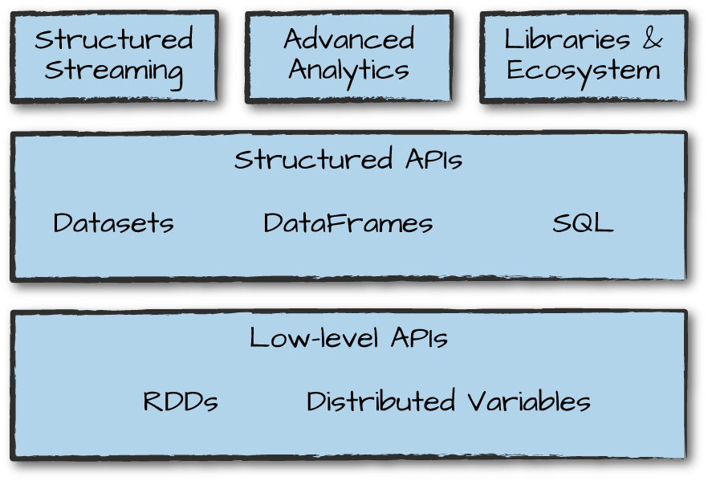
Lesson Objective and Overview
In this lesson, we will explore Spark SQL and DataFrames, focusing on their role in efficient data processing within Apache Spark. We will discuss the limitations of Spark RDDs and how DataFrames provide a more optimized solution. Additionally, we will perform column operations in PySpark to manipulate DataFrames.
By the end of this lesson, we will have hands-on experience working with DataFrames in Spark SQL, gaining essential skills for data transformation and analysis in PySpark.
img src: .oreilly.com

Slide 4
Learning Objective
Learning Objective:
By the end of this lesson, learners will be able to:
Describe SparkSQL, DataFrames, and the need for Spark DataFrames.
Learn how to create DataFrames in Spark.
Explore various features of DataFrames.
Discuss PySpark column operations to manipulate DataFrames.
Apply PySpark Queries on DataFrames.
Write and save data into files and databases from DataFrames.

Slide 5
Sample Dataset Resources
In this Spark lesson, we will use the below list of datasets for demonstration:
Click here for Download “airport.txt.”
Click here for Download “adult_data.csv.”
Click here for Download “word_count.txt.”
Click here for Download “cardataOne.txt.”
Click here for Download “cardataTwo.txt.”
Click here for Download “RealEstate.csv.”
Click here to Download “officecode.csv.”
Click here for Download “employee.csv.”
Click here for Download “cars.csv.”
Click here for Download “multiline_zipcode”
Click here for Download “zipcode.json”
Click here for Download “zipcode1.json”
Click here for Download “zipcode2.json”
Click here for Downoad “zipcodeData.csv”
Classicmodels database, Click here to download

Slide 6
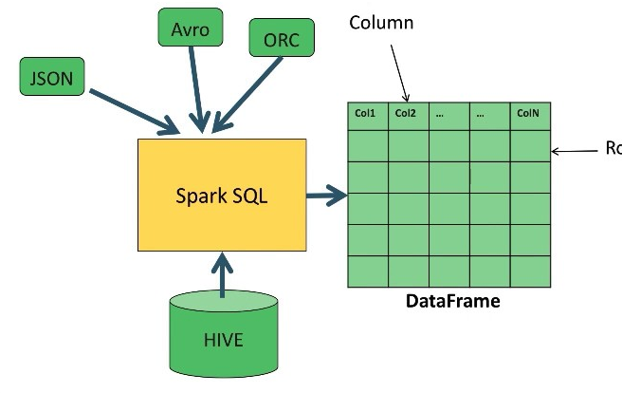
Spark SQL - Introduction (1 of 2)
Spark SQL is a module of Apache Spark designed for structured data processing. One of its key functionalities is the ability to execute SQL queries efficiently. It enhances Spark by providing a deeper understanding of data structure and computation.
Spark SQL introduces a powerful programming abstraction called DataFrames, which allows users to manipulate structured data with ease. It supports querying data using both SQL syntax and the Hive Query Language (HQL).
For users familiar with relational databases (RDBMS), Spark SQL provides a smooth transition, extending the capabilities of traditional relational data processing to handle relational, structured, semi-structured, and unstructured data seamlessly.
Ways to Manipulate Data in Spark SQL:
DataFrame / Dataset API – Enables programmatic data manipulation in Python, Scala, or Java.
SQL Queries – Allows direct querying using SQL syntax.
img src: medium.com
continue...

Slide 7
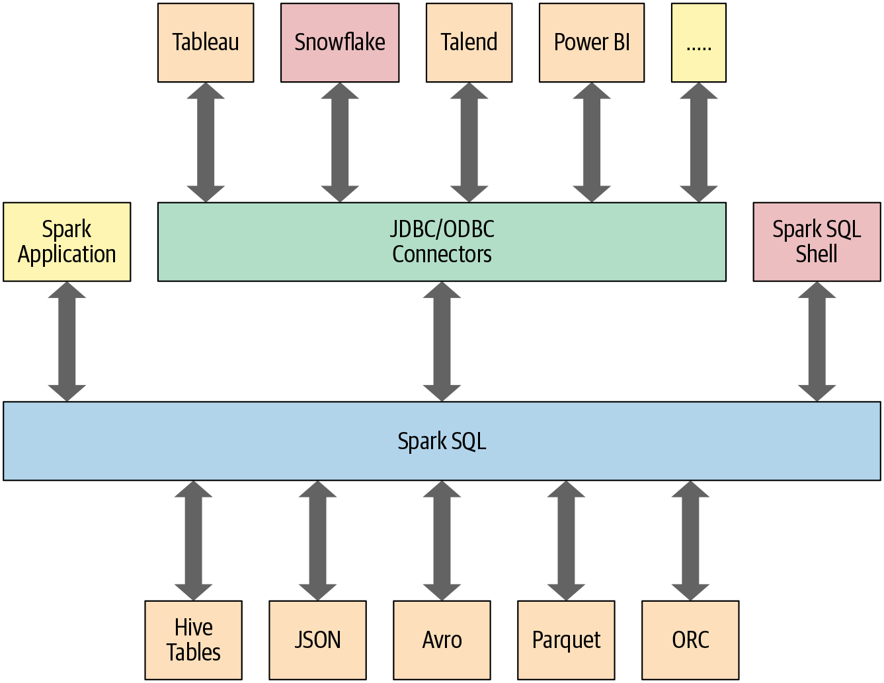
Spark SQL - Introduction (2 of 2)
Spark SQL is capable of:
Loading data from a variety of structured sources.
Querying data using SQL statements, both inside a Spark program and from external tools that connect to Spark SQL through standard database connectors (JDBC/ODBC) (e.g., using business intelligence tools like Tableau).
Providing rich integration between SQL and regular Python/Java/Scala code, including the ability to join RDDs and SQL tables, and expose custom functions in SQL and more.
img src: opensource.com

Slide 8
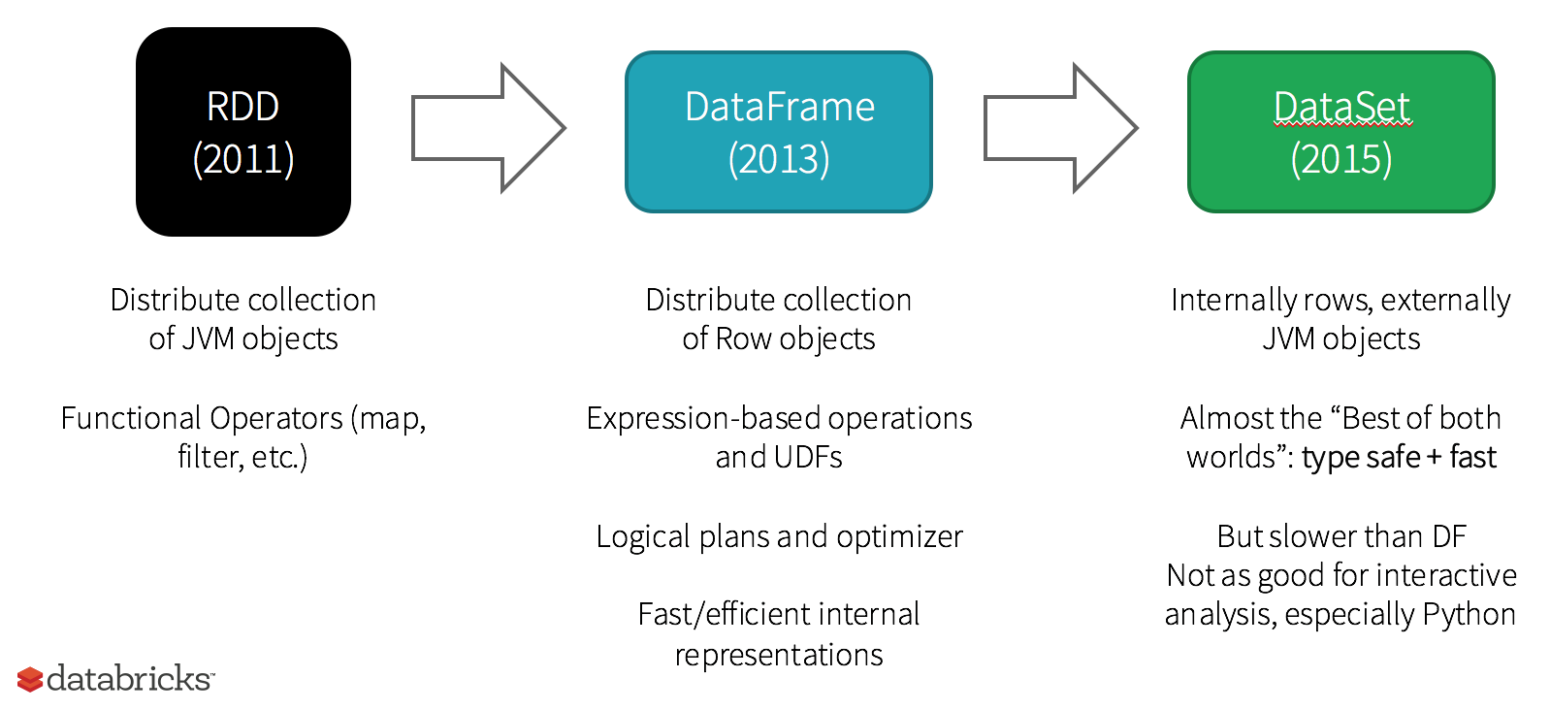
History of Spark APIs
img src: Databricks
RDD (Spark 1.0) —> Dataframe(Spark1.3DataFrame (Spark 1.3) —> Dataset(Spark1.6).
A dataset is an extension of a DataFrame; thus, we can consider a DataFrame an untyped view of a dataset.

Slide 9
Overview of the DataFrames API/Library
Spark SQL introduced a tabular data abstraction called a DataFrame since Spark 1.3.
DataFrames are similar to the table in a relational database but with more optimizations. The DataFrame is a distributed collection of rows (row types) with the same schema.
Data is described as a DataFrame with rows, columns, and a schema .
DataFrame = RDD + Schema:
The idea behind DataFrame is that it allows for the processing of a large amount of structured data. DataFrame is an abstraction, which gives a schema view of data. This means that it gives us a view of data as columns, with column names and type information. We can think of data in a DataFrame similar to a table in a database.
DataFrame in Apache Spark prevails over RDD but contains the features of RDD. The features common to RDD and DataFrame are immutability, in-memory, resilience, and distributed computing capability. It allows the user to impose the structure onto a distributed collection of data, thus providing higher-level abstraction.
DataFrame in Apache Spark was designed for modern big data and data science applications, taking its inspiration from data.frame in R and pandas in Python.

Slide 10
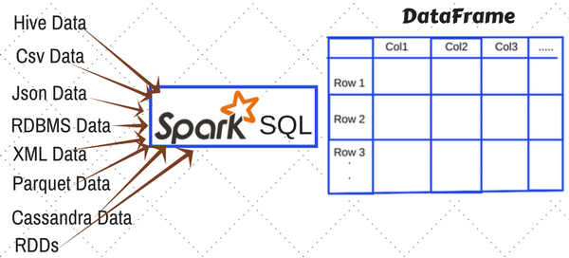
Creating a DataFrame
A DataFrame in Apache Spark can be created in multiple ways:
Create a DataFrame from the data source (e.g., load the data from JSON or CSV).
Create a DataFrame from an existing or new RDD.
Programmatically specify schema.
img src: spark.apache.org

Slide 11
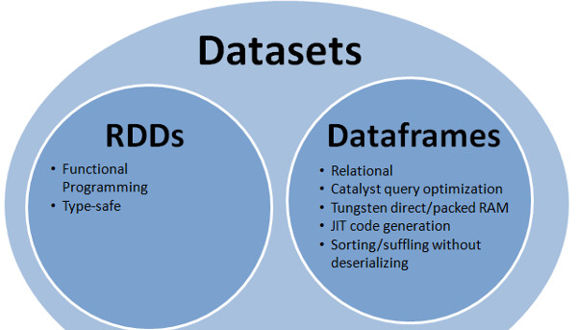
Overview of the Datasets API
A dataset is an extension of DataFrame; thus, we can consider a DataFrame an untyped view of a dataset.
A dataset is a distributed collection of data. Dataset API is a set of operators with typed and untyped transformations and actions to work with a structured query (as a Dataset) as a whole.
The dataset new interface added in Spark 1.6 combines RDD (strong typing, powerful lambda functions) and PySpark SQL's efficient execution engine.
Scala and Java have the Dataset API, but Python does not have the support for the Dataset API. Due to Python's dynamic nature, many of the benefits of the Dataset API are already available (i.e. you can access the field of a row by name naturally row.columnName).
img src: spark.apache.org
Click here for more details.
Notes:
https://spark.apache.org/docs/latest/sql-programming-guide.html

Slide 12
Pandas vs. PySpark DataFrame
Pandas and PySpark DataFrames are designed for structural and semi-structural data processing. They share similar properties, but there are a few significant differences:
Operations in Pyspark run in parallel on different nodes in the cluster. In Pandas, this is not possible.
Operations in PySpark are lazy (slow) in nature. In Pandas, we get the result as soon as we apply any operation.
Pandas is mutable; PySpark is immutable.
Pandas API supports more operations than PySpark's DataFrame; however, Pandas API is more powerful than PySpark.
Complex operations in Pandas are easier to perform than PySpark operations because Pandas API supports more operations than PySpark API.
In addition, Pandas and Pyspark DataFrames have some basic differences, such as column selections, filtering, adding columns, etc.

Slide 13
Video Optional
Spark SQL (pyspark) Dataframe Video:
Click here to play → https://www.youtube.com/watch?v=FcAiK2VtPfA

Slide 14
Overview of SparkSession
Since Spark 2.0, SparkSession is a new entry point to underlying Spark functionality. All functionality available with SparkContext is also available in SparkSession. Also, it provides APIs to work on DataFrames and Datasets.
With a SparkSession, applications can create DataFrames from an existing RDD or from different Spark data sources.
Spark Session also includes all of the APIs available in different contexts:
Spark Context.
SQL Context.
Streaming Context.
Hive Context.
Notes:
A SparkSession is a new entry point to Spark functionality that replaces the old SQLContext and HiveContext. It provides a single point of entry to interact with Spark, and it includes all of the SparkContext's functionality.

Slide 15
Overview of SparkSession (continued)
The getOrCreate() method is used to get an existing SparkSession. If there is no existing SparkSession, create a new one based on the options set in the builder.
You can create as many SparkSessions as you like in a Spark application by using either SparkSession.builder() or SparkSession.newSession().
import pyspark
from pyspark.sql import SparkSession
spark = SparkSession.builder.master('local[1]').appName('demo.com').getOrCreate()
appName() – Sets a name for the Spark application that shows in the Spark web UI. If no application name is set, it sets a random name.
We can stop SparkSession by using the line below:
spark.stop()
Notes:
When running it on the cluster you need to use your master name as an argument to master(). usually, it would be either yarn or mesos depends on your cluster setup.

Slide 16
SparkSession Commonly Use Methods
1. catalog – Returns the catalog object to access metadata.
2. builder() – Creates a new SparkSession using SparkSession.Builder.
3. createDataFrame() – Generates a DataFrame from a collection or RDD.
4. getActiveSession() – Retrieves the active SparkSession for the current thread.
5. read() – Provides access to DataFrameReader for reading data from CSV, Parquet, Avro, and other formats.
6. sparkContext() – Returns the SparkContext associated with the session.
7. sql(String sql) – Executes a SQL query and returns a DataFrame.
8. sqlContext() – Returns the SQLContext for Spark SQL operations.
9. stop() – Stops the current SparkContext, terminating the session.
10. table() – Returns a DataFrame from a specified table or view.
Notes:
These methods are essential for managing SparkSessions, querying data, and handling structured datasets efficiently.

Slide 17
Difference between Spark Context and Spark Session in PySpark
One key difference between the SparkContext and SparkSession is that the SparkSession is the preferred way to work with Spark data structures such as DataFrames and Datasets, as it provides a more consistent and simpler interface. The SparkContext is mainly used for lower-level operations, such as creating RDDs, accumulators, and broadcasting variables.
The SparkContext is a singleton and can only be created once in a Spark application. The SparkSession , on the other hand, can be created multiple times within an application.
The SparkContext is created using the SparkConf, which allows you to set various Spark configurations. The SparkSession , on the other hand, does not have a corresponding configuration object, but you can set configurations using the .config method of the SparkSession.
The SparkContext provides methods for creating RDDs, accumulators, and broadcasting variables, as well as methods for starting tasks on the executors. The SparkSession does not provide these methods, but it does provide methods for creating DataFrames and Datasets, as well as methods for reading and writing data.
The SparkContext is used to access the underlying Spark environment and perform operations on it. The SparkSession, on the other hand, is used to access the data stored in Spark and perform operations on it.

Slide 18
How to Create a DataFrames
A DataFrame in Apache Spark can be created multiple ways:
Create DataFrame from existing or new RDD: You can manually create a PySpark DataFrame using toDF() and createDataFrame(); both of these methods take different signatures in order to create a DataFrame from an existing RDD, a list [], and a DataFrame.
Create DataFrame from Data source: You can create PySpark DataFrame from data sources such as RDBMS, TXT files, CSV files, JSON files, Avro files, Parquet files, and other file formats by reading from HDFS, S3, DBFS, Azure Blob file systems, etc.
(continue)

Slide 19
Creating DataFrames
Let’s review some examples of how to create a DataFrame from a new RDD/existing RDD.
Go to the Next Slide...

Slide 20
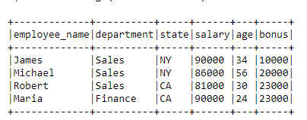
Example 1 - Create DataFrame From New RDD
In this example, the PySpark script creates a SparkSession, defines a sample dataset of employee details, and uses createDataFrame() to convert it into a DataFrame, displaying its schema and contents.
import pyspark
from pyspark.sql import SparkSession
spark = SparkSession.builder.appName('newRDDexample').getOrCreate()
simpleData = [("James","Sales","NY",90000,34,10000), \
("Michael","Sales","NY",86000,56,20000), \
("Robert","Sales","CA",81000,30,23000), \
("Maria","Finance","CA",90000,24,23000)]
columns = ["employee_name","department","state","salary","age","bonus"]
# ------Creating data frame Using createDataFrame() function-----
df = spark.createDataFrame(data = simpleData, schema = columns)
df.printSchema()
df.show(truncate=False)

Slide 21

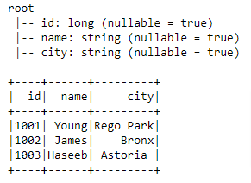
Example 2 - Create a PySpark DataFrame from Pandas DataFrame
In this example, we can create a PySparkSQL DataFrame from a Pandas DataFrame.
import pandas as pd
import pyspark
from pyspark.sql import SparkSession
spark = SparkSession.builder.appName('SpDataframe').getOrCreate()
student_dict = {"id": [1001, 1002, 1003],"name": [ "Young", "James", "Haseeb"],"city": [ "Rego Park", "Bronx", "Astoria"]}
# --- panda dataframe ----
pd_df = pd.DataFrame(student_dict)
print(pd_df)
# ----- SparkSQL dataframe-----
sp_df = spark.createDataFrame(pd_df)
sp_df.printSchema()
sp_df.show()

Slide 22
Create DataFrame From Data Sources
In real time, you create a DataFrame from data source files such as CSV, Text, JSON, and etc. PySpark, by default, supports many data formats out of the box without importing any libraries. To create DataFrame, you need to use the appropriate method available in DataFrame spark.read() class. Here is a list of some commonly used methods:
spark.read.text: Reads a text file (lines of text) into a DataFrame, with each line as a record.
spark.read.csv(): Reads a CSV (Comma Separated Values) file into a DataFrame.
spark.read.json(): Reads a JSON (JavaScript Object Notation) file into a DataFrame.
spark.read.parquet(): Reads a Parquet file into a DataFrame. Parquet is a columnar storage file format.
spark.read.orc(): Reads an ORC (Optimized Row Columnar) file into a DataFrame.
spark.read.jdbc(): Reads data from a JDBC (Java Database Connectivity) source into a DataFrame. This method requires specifying a JDBC URL, table name, and optional properties such as username and password.
spark.read.table(): Reads data from a Hive table into a DataFrame. This method is used for reading data from a Hive metastore.
spark.read.format(): Specifies a custom data source format and allows specifying additional options for reading data. For example, spark.read.format("avro").
spark.read.option(): Specifies additional options for reading data from a specific data source. For example, spark.read.option("header", "true").
spark.read.load(): Loads data from a specified path into a DataFrame based on the specified format and options. This method is often used in conjunction with format and option.
Notes:
# Example: Reading from CSV
df_csv = spark.read.csv("path_to_your_csv_file.csv", header=True, inferSchema=True)
# Example: Reading from JSON
df_json = spark.read.json("path_to_your_json_file.json")
# Example: Reading from Parquet
df_parquet = spark.read.parquet("path_to_your_parquet_file.parquet")

Slide 23
Create DataFrame From Data Sources
If we read/access data from any external source such as CSV or JSON, we must first create a DataFrameReader. A DataFrameReader is the foundation for reading data in Spark; it can be accessed via the spark.read() class
Basic Syntax:
JSON Example: dataframe = SparkSession.read.json('path/nyt2.json')
TEXT FILES Example : dataframe_txt = SparkSession.read.text('path/text_data.txt')
CSV FILES Example: dataframe_csv = SparkSession.read.csv('path/csv_data.csv')
PARQUET FILES Example: dataframe_parquet = SparkSession.read.load('path/parquet_data.parquet')

Slide 24
Example 3 - Create DataFrame From Data Sources
Example: Read CSV file into a DataFrame.
import pyspark
from pyspark.sql import SparkSession
spark = SparkSession.builder.appName('Sparkapplicationdemo').getOrCreate()
df = spark.read.load("C:/Users/RealEstate.csv", format="csv", header = True,inferSchema = True)
df.printSchema()
df.show()
The inferSchema and header parameters are mandatory whenever reading CSV files; without them, Spark will cast every data type to string and treat the header row as actual data:

Slide 25
Example 3 - Create DataFrame From Data Sources
Example: Read JSON file into dataframe
import pyspark
from pyspark.sql import SparkSession
# Creating a Spark session
spark = SparkSession.builder.appName('SparkApplicationDemo').getOrCreate()
df = spark.read.json("C:/Users/zipcode.json")
df.printSchema()
df.show()
Example: Read JSON File with Multiple Lines into DataFrame
import pyspark
from pyspark.sql import SparkSession
# Creating a Spark session
spark = SparkSession.builder.appName('SparkApplicationDemo').getOrCreate()
# Reading a JSON file with multiple lines into a DataFrame
df = spark.read.option("multiline", "true").json("C:/Users/multiline-zipcode.json")
# Displaying the schema of the DataFrame
df.printSchema()
# Showing the first few rows of the DataFrame
df.show()
we use the option("multiline", "true") to handle JSON files with multiple lines
Notes:
option("multiline", "true") is used to instruct Spark to read the JSON file with multiple lines as a single JSON object. This ensures that each JSON object spanning multiple lines is properly read and parsed into a DataFrame.

Slide 26
Example 3 - Create DataFrame From Data Sources
Example: Read Multiple JSON Files into DataFrame
spark = SparkSession.builder.appName('ReadingmultipleJSON').getOrCreate()
# Reading multiple JSON files into a DataFrame
df_multiple = spark.read.json([
'C:/Users/zipcode2.json',
'C:/Users/zipcode1.json'
])
# Displaying the DataFrame
df_multiple.show()
we read multiple JSON files into a single DataFrame using the spark.read.json() method with a list of file paths.
Example: Read all JSON Files from directory
spark = SparkSession.builder.appName('SparkApplicationDemo').getOrCreate()
# Reading all JSON files from a directory into a DataFrame
df_all_files = spark.read.json("C:/Users/*.json")
# Displaying the DataFrame
df_all_files.show()
# Stop the SparkSession
spark.stop()
we use the spark.read.json() method with a wildcard(*) in the file path to read all JSON files present in the specified directory into a single DataFrame.

Slide 27
Example 4 - Create DataFrame from MySQL Database
Spark session also provides a sql() method, which allows you to run SQL queries on the data in a DataFrame.
example spark.sql("SELECT * FROM myTableName").
All spark.sql() queries executed in this manner return a DataFrame on which you may perform further Spark operations.

Slide 28
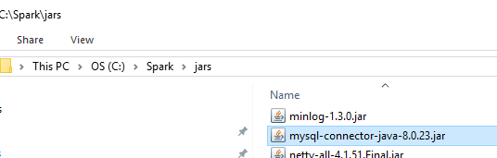
Example 4 - Create DataFrame from MySQL Database
We also can create a DataFrame from different database sources such as SQL, Oracle, and PostgreSQL. Let’s read data from SQL using a JDBC connection. We will use the “classicmodels” database in this example.
Note: If you do not have the “classicmodels” database, you need to import the “classicmodels” database in MySQL Workbench.
1 - Setting Up SQL Connector for Spark:
When we want Spark to communicate with RDBMS, we need a compatible connector. For SQL, you can download its connector at this link: SQL Connector. Once you download it, move it into the C:/Spark/jars folder, and if you are using Jupyter notebook, you must RESTART your Notebook
(continue…)

Slide 29
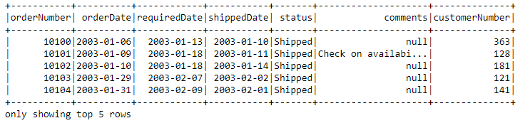
Example 4 - Create DataFrame from MySQL Database
2 - Read Full Data from MySQL and add data into the PySpark DataFrame.
Creating SparkSession:
from pyspark.sql import SparkSession
spark = SparkSession.builder.master("local[*]").appName("Test SQL app").getOrCreate()
The lines below will create a connection from the “classicmodels” database and fetch data from the orders table. In a return, we will get orders table data in a Dataframe
df=spark.read.format("jdbc").options(driver="com.mysql.cj.jdbc.Driver",\
user="root",\
password="password",\
url="jdbc:mysql://localhost:3306/classicmodels",\
dbtable="classicmodels.orders").load()
df.show()
output
Notes:
Do not forget to change the user and password,

Slide 30
Overview of StructType & StructField (1 of 1)
StructType() and StructField() methods are used to define the columns in the Spark DataFrame and Spark Dataset.
Using these methods, we can define the column names and the data types of the particular columns, ensuring consistency and type safety.
StructType(): This method is used to define the structure of the Spark dataframe. It will accept a list of data types, along with column names for the given dataframe. This is known as the schema of the dataframe. It stores a collection of fields.
It is commonly used when creating DataFrames programmatically or when reading data from external sources where the schema is not predefined.
StructField(): This method is used inside the StructType() method of the Spark dataframe. It will accept column names with the datatype. StructField() is used to add columns to the DataFrame, which takes column names as the first parameter and the datatype of the particular columns as the second parameter.
StructFields are immutable and can be defined explicitly when creating a StructType or inferred from existing data.
Syntax:
from pyspark.sql.types import StructType,StructField, StringType, IntegerType,BooleanType,DoubleType
Here, schema refers to the DataFrame when it is created
schema=StructType([
StructField("column 1", datatype,True/False),
StructField("column 2", datatype,True/False),
StructField("column n", datatype,True/False)
])
Notes:
Together, StructType and StructField provide a powerful mechanism for defining and managing the schema of structured data in Spark. They ensure data consistency, type safety, and efficient processing of large-scale datasets.

Slide 31
Overview of StructType & StructField (1 of 2)
In PySpark, we use data types from the pyspark.sql.types module to define schema structures for DataFrames.
StringType() – Stores string values.
IntegerType() – Stores integer or long integer values.
FloatType() – Stores floating-point values with single precision.
DoubleType() – Stores double-precision floating-point values.
These data types ensure efficient data processing and schema validation in PySpark DataFrames

Slide 32
Hands-On Labs: Working with DataFrames in PySpark
The following labs cover creating DataFrames in PySpark, defining a schema using StructType and StructField, and specifying data types (string, integer, float). The labs also cover loading data from CSV, JSON, and RDBMS files, filtering data, and displaying schemas for structured data analysis.
Click here for GLAB 345.2.1 - PYSQL - StructType & StructField.
Click here for GLAB 345.2.2 - PYSQL - StructType & StructField
Click here for GLAB 345.2.3 - PYSQL - Create DataFrame From the Data Sources (CSV and JSON)
Click here for GLAB 345.2.4 - PYSQL - Create DataFrame from Data source (RDBMS)

Slide 33
Methods in Spark DataFrame (1 of 2)
There are several methods that we can use for data inspection; below, you will find some of the most common. For a deeper look, visit the Apache Spark doc.
# Return Schema
dataframe.printSchema()
# Returns dataframe column names and data types
dataframe.dtypes
# Return all rows
dataframe.show()
# Return first n rows
dataframe.head()
# Returns first row
dataframe.first()
# Return first n rows
dataframe.take(5)
# Returns columns of dataframe
dataframe.columns
# Counts number of rows in dataframe
dataframe.count()
# Counts number of distinct rows in dataframe
dataframe.distinct().count()
# Prints plans including physical and logical
dataframe.explain()

Slide 34
Methods in Spark DataFrame (2 of 2)
Below are some common DataFrame methods that we can use for data manipulation.
DataFrame Transformations:
select()
filter()
groupby()
orderBy()
dropDuplicates()
withColumnRenamed()
DataFrame Actions:
printSchema()
show()
count()
columns()
describe()

Slide 35
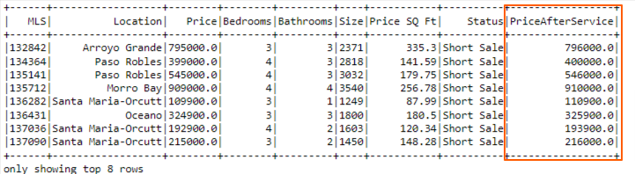
Creating a New Column in DataFrame
How do I add the new column in the DataFrame?
We can use the `withColumn` operation to add (or replace) a new column in a base DataFrame and return a new DataFrame. The withColumn operation will take two parameters.
Column name, which we want to add or replace.
Expression on the column.
Let’s see how withColumn works. We are adding a new column named 'PriceAfterService` in an existing DataFrame, and we are adding 1,000 in the Price column.
import pyspark
from pyspark.sql import SparkSession
spark = SparkSession.builder.appName('Sparkapplicationdemo').getOrCreate()
df = spark.read.load("C:/Users/RealEstate.csv", format="csv", header = True,inferSchema = True)
df.show(8)
new_df= df.withColumn('PriceAfterService', df.Price + 1000)
# Checking the Updated DataFrame
new_df.show(8)

Slide 36
DataFrames: select() Operation
The Spark SQL select() method is used to select one or more columns from the DataFrame and Dataset. It is possible to obtain columns by attribute (“columnsname”) or by indexing (dataframe[columnsname]).
The select() method is a transformation operation and returns a new DataFrame or Dataset with the selected columns.
In the below example, we use PySpark to read a CSV file into a DataFrame and perform basic data selection operations using select() method.
import pyspark
from pyspark.sql import SparkSession
spark = SparkSession.builder.appName('Sparkapplicationdemo').getOrCreate()
# Reading the Dataset
df = spark.read.load("C:/Users/RealEstate.csv", format="csv", header = True,inferSchema = True)
#Show all entries in Location column
df.select("Location").show(20)
#Show all entries in Location, Price, rank, Status columns
df.select("Location", "Price", "Status").show(30)

Slide 37
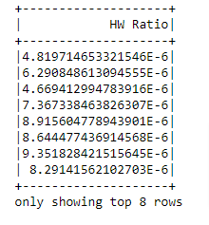
Example: select() and withColumn()
"In this example, we will create a new DataFrame with a column called 'HW Ratio,' which represents the ratio of a car's weight to its horsepower, using the select() and withColumn() methods.
import pyspark
from pyspark.sql import SparkSession
spark = SparkSession.builder.appName('SelectandColumn').getOrCreate()
cardf = spark.read.load("C:/Users/cars.csv", format="csv", header = True,inferSchema = True)
cardf.withColumn('HW Ratio', cardf['Weight'] / cardf['Horsepower']).select('HW Ratio').show()

Slide 38
Example - select()
Problem:
What is the average weight of the car?
What is the maximum and minimum quantity of the car?
import pyspark
from pyspark.sql import SparkSession
from pyspark.sql.functions import mean,avg,max,min
spark = SparkSession.builder.appName('Sparkapp.com').getOrCreate()
cardf = spark.read.load("C:/Users/cars.csv", format="csv", header = True,inferSchema = True)
#We can use either the mean module or avg module as shown below
cardf.select(mean("Weight")).show()
#Alternate
cardf.select(avg('Weight')).show()
cardf.select(max("quantity"),min("quantity")).show()

Slide 39
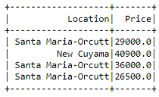
DataFrames - filter() operation
The filter() method filters the DataFrame and returns only the rows or columns that are specified in the filter.
Example: Filtering the data:
import pyspark
from pyspark.sql import SparkSession
spark = SparkSession.builder.appName('Sparkapplicationdemo').getOrCreate()
# Reading the Dataset
df = spark.read.load("C:/Users/RealEstate.csv", format="csv", header = True,inferSchema = True)
df.select('Location','Price').filter(df['Price'] < 50000).show ()
# Alternate
# df.select('Location','Price').filter(df.Price < 50000).show ()
Notes:
Download RealEstate.csv file from slide number 4

Slide 40
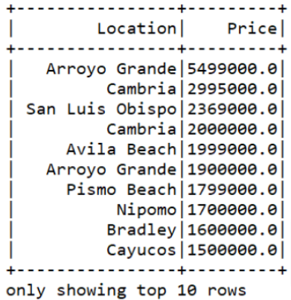
DataFrames: sort() operation
Sorting the data: We can use the sort() method on the DataFrame to get sorted output based on some column.
Example: The objective of this code is to read a real estate dataset, extract specific columns, and sort the data in descending order based on price by using sort() method.
import pyspark
from pyspark.sql import SparkSession
spark = SparkSession.builder.appName('Sparkapplicationdemo').getOrCreate()
# Reading the Dataset
df = spark.read.load("C:/Users/RealEstate.csv", format="csv", header = True,inferSchema = True)
df.select("Location", "Price").sort(df["Price"].desc()).show(100)

Slide 41
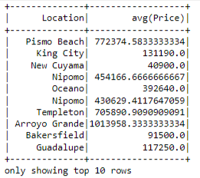
DataFrames - groupby() and average() Operation
Grouping the data by column(s): In this example, we will read a CSV dataset (RealEstate.csv) into a DataFrame, selecting the columns "Location" and "Price". It then groups the data by "Location" and calculates the average price for each location using .groupBy("Location").avg(). Finally, the first 10 results are displayed using .show(10), enabling aggregate analysis of real estate prices across different locations.
import pyspark
from pyspark.sql import SparkSession
spark = SparkSession.builder.appName('Sparkapplicationdemo').getOrCreate()
# Reading the Dataset
df = spark.read.load("C:/Users/RealEstate.csv", format="csv", header = True, inferSchema = True)
df.select("Location", "Price").groupby("Location").avg().show(10)

Slide 42
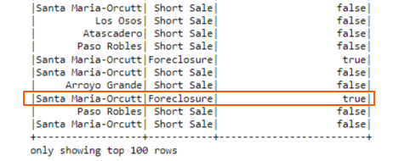
DataFrames - like() Operator
Searching data using the LIKE operator: In this example, we will read a CSV dataset (RealEstate.csv) into a DataFrame and select the columns "Location" and "Status." The .like("%Foreclosure%") operation is applied to filter rows where the "Status" column contains the word "Foreclosure". Finally, the results are displayed using .show(100), helping in identifying foreclosure properties in different locations
import pyspark
from pyspark.sql import SparkSession
spark = SparkSession.builder.appName('Sparkapplicationdemo').getOrCreate()
# Reading the Dataset
df = spark.read.load("C:/Users/RealEstate.csv", format="csv", header = True,inferSchema = True)
df.select("Location", "Status", df.Status.like("%Foreclosure%")).show(100)

Slide 43
Challenge Exercise 3
Download the CSV dataset of the StackOverflow 2019 survey:
Using Spark SQL, create DataFrames that filter for the following:
Top five countries by number of respondents.

Slide 44
Overview of PySpark SQL
PySpark SQL is a module in Apache Spark that allows querying structured data using SQL-like syntax or the DataFrame API. It enables fast and scalable data processing, similar to working with relational databases.\
Familiar SQL Syntax – Great for users coming from SQL backgrounds.
Plain SQL queries can be significantly more concise and easier to understand. Every supported language can use them without any modifications, making them portable.
img src: oreilly.com

Slide 45
How to Apply PySpark Queries on DataFrames?
PySpark allows querying structured data from DataFrames, Parquet files, JSON, CSV, and databases using:
SQL Queries on DataFrames: You can register a DataFrame as a temporary SQL table using df.createOrReplaceTempView() and then run SQL queries using spark.sql().
SQL-like Operations with DataFrame API: The DataFrame API provides methods similar to SQL queries, such as select(), filter(), groupBy(), agg(), etc.

Slide 46
Applying PySpark Queries on DataFrames
Creating views has a similar syntax to creating tables within a SQL database. Once you create a view, you can query it as you would a table. The difference between a view and a table is that views do not actually hold the data. Tables persist after the Spark application terminates, but views disappear.
To apply Spark SQL queries on DataFrames, first, we need to register the data in the DataFrame as a table by using createTempView(tablename) method.
The createTempView(tablename) method is the simplest way to create a temporary view that can later be used to query the data. The only required parameter is the name of the table.
After that, we can use the sql() method of SparkSession to enable our applications to run SQL queries programmatically and return the result sets as DataFrame structures.
import pyspark
from pyspark.sql import SparkSession
spark = SparkSession.builder.appName('Sparkappdemo').getOrCreate()
zipdf = spark.read.json("C:/Users/zipcode1.json")
zipdf.createTempView("ziptable1")
spark.sql("SELECT count(*) from ziptable1").show()
#alternate: spark.sql("SELECT count(*) from ziptable1")
Notes:
For more detailed information, kindly visit Apache Spark docs.

Slide 47
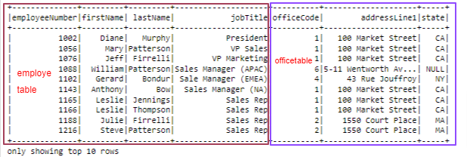
Example: Running PySpark SQL Queries
empdf = spark.read.load("C:/Users/employee.csv", format="csv", header = True,inferSchema = True)
empdf.printSchema()
officedf = spark.read.load("C:/Users/officecode.csv", format="csv", header = True ,inferSchema = True)
empdf.printSchema()
empdf.createTempView("employee_table")
officedf.createTempView("office_table")
spark.sql("SELECT employee_table.employeeNumber, employee_table.firstName,employee_table.lastName,jobTitle, employee_table.officeCode, \
office_table.addressLine1, office_table.state FROM employee_table \
join office_table ON office_table.officeCode = employee_table.officeCode").show(10)
In this example, we are getting data from two CSV files and then joining the data using SQL join operation.

Slide 48
Example - PySpark SQL
This lab focuses on using PySpark SQL to query Spark DataFrames, providing hands-on experience with this aspect of Spark
Click here to Download GLAB 345.2.5 - How to Use PySpark SQL to Query Spark DataFrames

Slide 49
Spark SQL Built-in Standard Functions
Spark SQL provides several built-in, standard function libraries named “spark.sql.functions” to work with DataFrame/Dataset and SQL queries for Data manipulation and Data analyzing.
In order to use these SQL standard functions, you need to import the below PySpark module/package into your application.
from pyspark.sql.functions import [moduleName]
Example:
from pyspark.sql.functions import mean
from pyspark.sql.functions import year
from pyspark.sql.functions import avg
from pyspark.sql.functions import min, max
We also can import all Spark SQL function libraries into the application by using [ * ] as shown below:
from pyspark.sql.functions import*
Click here to view the Spark SQL Functions document.

Slide 50
Knowledge Check
What are the key differences between RDD and DataFrame?
What do you understand about SparkSession in Pyspark?
Can we create PySpark DataFrame from external data sources?

Slide 51
Writing/Saving Data to RDBMS from a Spark DataFrame
We can write data from a Spark DataFrame to any JDBC-compatible database using the JDBC connection API:
spark.DataFrame.write.format('jdbc')
This above API provides various configuration options, allowing users to customize schemas and specify additional parameters when executing CREATE TABLE statements.
The write() method is used to write data from a Spark DataFrame to an RDBMS (Relational Database Management System) table. Additionally, the option() and mode() methods control the writing behavior:
mode(): Specifies how Spark should handle existing data when writing.
append Mode: Appends new data to the existing database table without modifying existing records.
overwrite Mode: Replaces existing data by overwriting the table. If the table does not exist, it will be created unless the TRUNCATE option is used.
df.write.format("jdbc") \
.mode("append") \
.option("url", "jdbc:mysql://localhost:3306/DataBaseName") \
.option("dbtable", "TableName") \
.option("user", "root") \
.option("password", "password") \
.save()
Basic Syntax

Slide 52
Example One - Write/Save Data to RDBMS (1 of 2)
In this example, we will write data into RDBMS from the Spark DataFrame.
We are connecting the “classicmodels” database and table will be created by the name of “Employees_forSparkDemo,” along with data automatically
#import findspark
#findspark.init()
# use above lines if you are getting errors
from pyspark. sql import SparkSession
spark = SparkSession.builder.getOrCreate()
# -- initializing data ---
simpleData = [(1,"James","Sales","NY",90000), \
(2,"Michael","Sales","NY",86000), \
(3,"Robert","Sales","CA",81000), \
(4,"Maria","Finance","CA",90000)]
#---- Declare schema for data-----
columns = ["EMPLOYEEID","employee_name","department","state","salary"]
# --- Creating data frame Using createDataFrame() function-----
df = spark.createDataFrame(data = simpleData, schema = columns)
df.printSchema()
#---- save the dataframe to the MySQL table-----
df.write.format("jdbc") \
.mode("append") \
.option("url", "jdbc:mysql://localhost:3306/classicmodels") \
.option("dbtable", "classicmodels.Employees_forSparkDemo") \
.option("user", "root") \
.option("password", "password") \
.save()

Slide 53
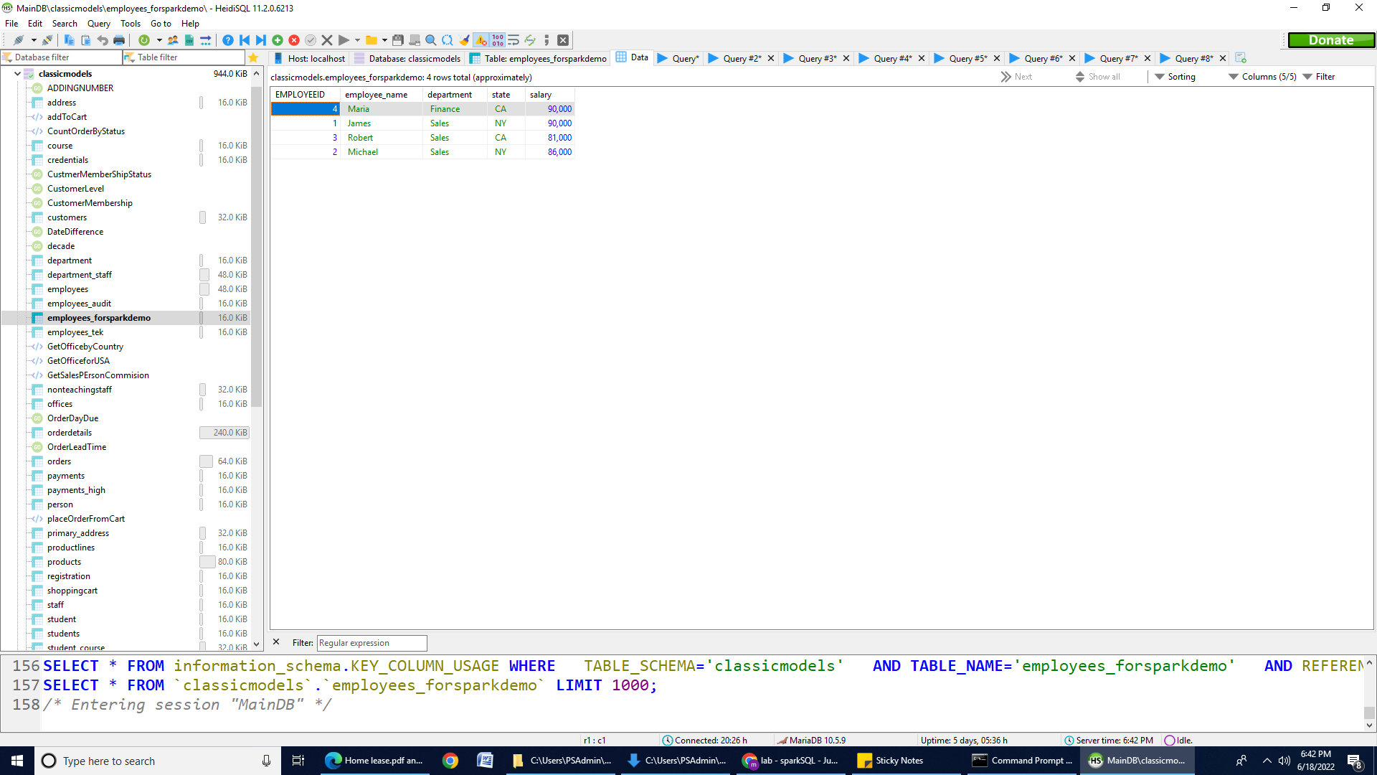
Example One - Write/Save Data to RDBMS (2 of 2)
Result: The table will be created by the name of Employees_forSparkDemo in the “classicmodels” database.

Slide 54
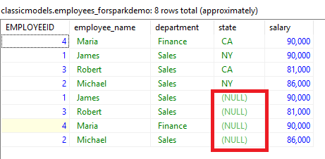
Example Two - Write/Save Data to RDBMS
We can write a specific column from the Spark DataFrame into RDBMS by using the select() method. See the example below:
df.select("EMPLOYEEID","employee_name","department","salary").write.format("jdbc") \
.mode("append") \
.option("url", "jdbc:mysql://localhost:3306/classicmodels") \
.option("dbtable", "classicmodels.Employees_forSparkDemo") \
.option("user", "root") \
.option("password", "password") \
.save()
Result: After running the above code, open the “Employees_forSparkDemo” table and you will notice that the “state” column is empty now, as shown in the screenshot.

Slide 55
Guided labs for PySpark and DataPipline
Complete the following labs
GLAB 345.2.6 - PySpark DataFrame, Queries and matplotlib
GLAB 345.2.7 - RESTful API Integration with PySpark and MySQL
You can find these labs on Canvas under the Assignment section.

Slide 56
Summary
In this module, we explored the PySpark column Operations, and the way to manipulate any PySpark DataFrame. The skill to perform these methods are a must-have.
Most methods work similar to Pandas DataFrame and have method names similar to those used in SQL. A person having some experience, would require no time to learn how to perform these methods. All of the methods explored in this module can be used in a more optimized way. One can try using these methods in a more time and memory-conservative way.

Slide 57
References
https://community.databricks.com/s/question/0D53f00001HKHpwCAH/what-is-the-difference-between-createtempview-createglobaltempview-and-registertemptable
https://dbmstutorials.com/pyspark/spark-db-to-dataframe.html
https://s3.amazonaws.com/assets.datacamp.com/blog_assets/PySpark_SQL_Cheat_Sheet_Python.pdf

Slide 58
THANK YOU

